Slide 1
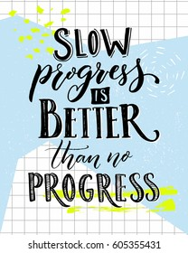
Date: | Human Biology Year 12 ATAR
Do Now Do the past exam questions given. Lesson Agenda 1: Do Now 2: Other Endocrine Glands and Tissues 3: Write notes on each of the hormones studied so far, including: What stimulates their release How their secretion is regulated (in detail) Their effect on the body Feedback systems involved 4: Lesson summary and wind-up Suggested Study Finish the notes sheet on the different hormones Read through today’s notes and textbook section Practice drawing flowcharts for insulin and glucagon regulation NEXT LESSON Formative Quiz on today’s work (not for marks) Consolidation of Work so Far | Learning Aims Describe the location and function of the Thymus. Describe the location and function of the Pineal. Describe the function of the gonads and the hormones they produce. Be aware of other organs and tissues that secrete hormones.
 | Key Vocabulary Thymus Pineal Melatonin

Slide 2
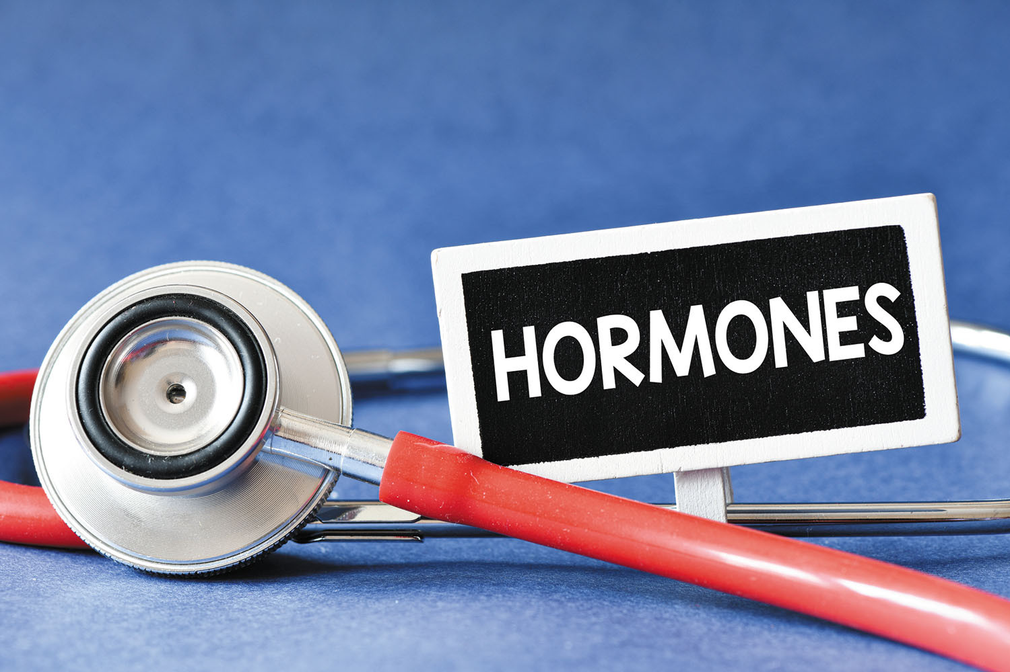
Other Endocrine Organs and Tissues
Thymus
Pineal
Gonads
And more…

Slide 3
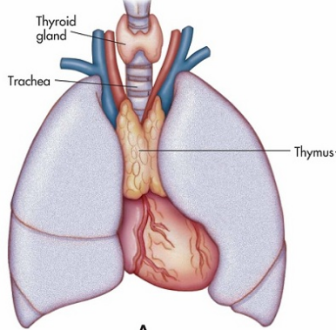
The Thymus
Largest in infants and children, shrinks in adulthood
Located in top of chest
Secretes Thymosins
Thymosins help mature T-lymphocytes – involved in immunity
Learning Aim: Describe the location and function of the thymus

Slide 4
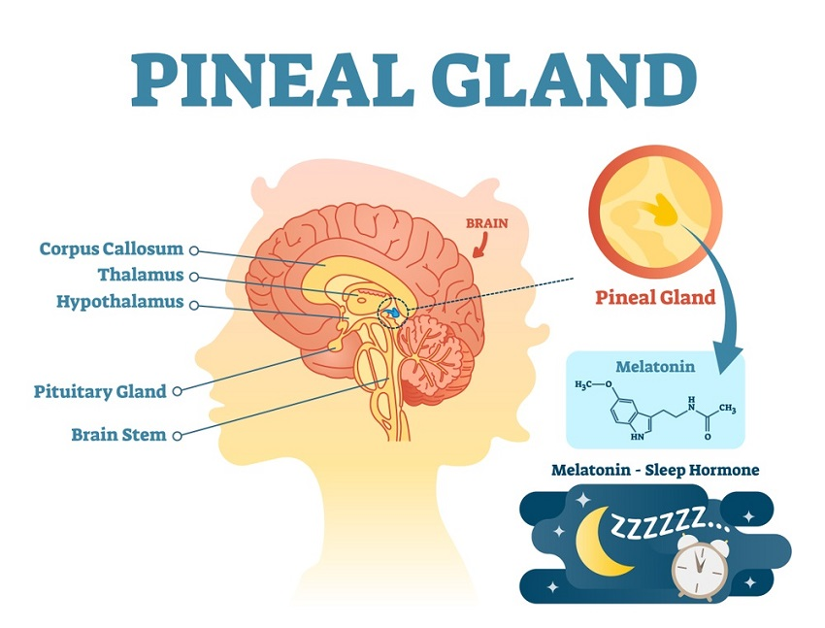
The Pineal Gland
Found deep in the brain
Size of pea in childhood, decreases in size and eventually calcifies during adulthood and old age.
Secretes melatonin – involved in regulating sleep patterns.
Secretion of melatonin is stimulated by darkness and inhibited by light
Learning Aim: Describe the location and function of the pineal

Slide 5
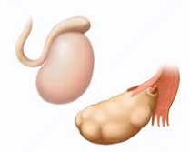
The Gonads
Ovaries and Testes
Stimulated by FSH and LH from the anterior pituitary after signalling with GnRF from hypothalamus
Release hormones:
Oestrogen and Progesterone: maintain menstrual cycle, development and maintenance of female sex characteristics.
Androgens (eg Testosterone): male sex hormones. Develop and maintain male sex characteristics.
Note: These are not in the syllabus for Year 12 Human Biology so should not be asked in any assessment.
Learning Aim: Describe the function of the gonads and the hormones they produce.

Slide 6
Other endocrine tissues
Stomach and small intestine:
Secrete some hormones that coordinate digestion
Kidneys:
Secrete erythropoietin (EPO) – stimulates RBC production.
Heart
Secretes atrionatriuretic factor – helps reduce blood pressure – interacts with aldosterone regulation
Placenta
Secretes hormones that help to maintain pregnancy, assist foetal development and stimulate lactation.
Learning Aim: Be aware of other organs and tissues that secrete hormones

